Slide 1
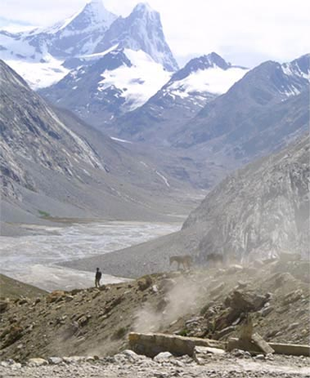
Fellowship of the Heart
Getting Started — the Four Connects, walked around the table on alternating evenings
Evening Series 2026–27 · at the Tittle home · v1.5E DRAFT
All Scripture: ESV · The Companion lesson plans carry the full scripts — these slides carry the room
1
Notes:
DECK TITLE · pre-session · DIVIDER
On screen as the room assembles on night one. All Scripture ESV; the plans carry the scripts; these slides carry the room — and these notes carry you.

Slide 2

SESSION 5
Knowing and Being Known
The four conditions of a container, applied to your real friendships
Quarter 1: Connect with Self & Others
59
Notes:
S5 · pre-session · DIVIDER
On screen through dinner and as the circle forms. Greet at the door — the slide holds the room.

Slide 3

Session 5 — Tonight’s Road
1 Welcome and centering
2 Check-in — the practice since we last met
3 The four conditions — teaching
4 Bridge to split
5 Friendship-mapping exercise
6 Merge and surface common patterns
7 Homework commissioning — handout + partners
8 The Leader Feedback Round — both leaders
9 Closing container
60
Notes:
S5 · 7:00–8:30 · BOTH LEADERS
BEATS:
1. Movement two begins: Connect with Others. Today names the four conditions that have been holding this room — Safe, Present, Clear, Intentional — then maps them onto real friendships in pairs.
2. Shape: open, check-in, 15-minute whiteboard teaching, bridge, 28-minute friendship-mapping, merge patterns, practice, feedback, close.
3. Risk profile is nearer Week 2 than Week 3 — but 'I don't have a single friend who knows me' from a teen is its own quiet emergency; receive it and follow up within 48 hours.
CUES: Whiteboard pre-written vertically: SAFE / PRESENT / CLEAR / INTENTIONAL. Opening parent arranged per cluster.

Slide 4
Opening Container — the Eight Steps
1 Welcome — five minutes to open the container
2 Phones silenced and put away
3 Stand in a circle
4 One-word check-in — how you actually are, right now
5 Put out / bring in — set something down; bring a blessing in
6 Spoken commitment: “I am here. I am paying attention. I am willing to be moved.”
7 Opening prayer — “Holy Spirit, you are welcome here. Speak. We are listening.”
8 Sit. Begin.
61
Notes:
S5 · 7:00–7:08 · LEAD: CONTAINER HOLDER
BEATS:
1. Blessing over the room; let it settle first.
2. Frame: the first four weeks were Connect with Self — the soil, then the story told all the way around, parents first. Today begins Others; two weeks here.
3. Today we make visible the four conditions that have been quietly holding our work — then ask where else each is present in our lives, and where missing.
4. Container reminders, briefly: what is said here stays here; nothing required; we listen to receive, not to fix.

Slide 5

Check-In — the Practice Since We Last Met
• “Some of you got to it. Some didn’t. Both are fine.”
• “Anyone want to say one sentence about how that landed for you?”
• Receive without commentary
• “Good. Some of that work continues whether or not we got to it.”
62
Notes:
S5 · 7:08–7:25 · LEAD: CONTAINER HOLDER
BEATS:
1. Check on the practice since we last met, and the midweek reports: one sentence each; a parent starts the sharing.
2. Take 3–4 voluntary contributions; receive without commentary.
3. Move on: 'Some of that work continues whether or not we got to it this week.'

Slide 6
The Four Conditions
1 SAFE — the hearing condition. “I will not be judged as a person while I am doing my work” — Romans 14:3–4
2 PRESENT — the attention condition. “I am actually here” — aware that the Great I AM is also here — Revelation 1:8
3 CLEAR — the channel condition. Nothing unaddressed between God and me, or the circle and me — Matthew 7:5
4 INTENTIONAL — the obedience condition. On purpose, watching for what God is doing, willing to do it — John 5:19
ECCLESIASTES 4:9–12
“Two are better than one, because they have a good reward for their toil. For if they fall, one will lift up his fellow. … And though a man might prevail against one who is alone, two will withstand him—a threefold cord is not quickly broken.”
63
Notes:
S5 · 7:25–7:42 · LEAD: CONTENT PRESENTER
OPENING LINES (moved from the slide): The threefold cord is stronger because the strands hold each other in tension — the strength is in the holding.
Four conditions have been quietly holding this room for four weeks. Tonight we name them.
BEATS:
1. Read Ecclesiastes 4:9–12 — the threefold cord's strength is in the holding.
2. Walk each condition 2–3 minutes at the whiteboard: SAFE, the hearing condition (not judged while doing my work — Rom 14:3–4); PRESENT, the attention condition (actually here — Rev 1:8); CLEAR, the channel condition (nothing unaddressed — Matt 7:5); INTENTIONAL, the obedience condition (willing to do what He shows — John 5:19).
3. Teach lightly — the cluster exercise does the depth work.
GUARD: This is not friendship tips. Stay with the four conditions as defined, and do not run long — the mapping block needs its full 28 minutes.

Slide 7
Bridge to the Split
• Each cluster takes the four conditions and asks: “for each one, where in my actual friendships does this show up? And where is it missing?”
• “We are not naming names tonight. ‘One of my friends’ is fine.” — we map conditions, not people
• Your Companion goes first on every condition, then one of the parents opens the round
• Teens, you choose your own depth. Pass anytime
• Twenty-eight minutes — same rooms as the last two weeks
64
Notes:
S5 · 7:42–7:43 · LEAD: CONTENT PRESENTER · TRANSITION
BEATS:
1. Frame the exercise: for each condition — where does it show up in my actual friendships, and where is it missing? Worksheets are on the chairs.
2. Name the language rule: no names — 'one of my friendships,' 'one adult relationship in my life.'
3. Pray and send: same rooms; back at 5:11. Ten or fewer — stay one circle.
CUES: In each cluster the Companion goes first on every condition, then the arranged parent opens; teens choose their own depth after; pass anytime.

Slide 8

Friendship-Mapping in Pairs
• Four conditions, about six minutes each — a leader models first, a parent opens the round
• Each turn 30–60 seconds — specific: one friendship where the condition is present, one where it is missing
• “No names of people who aren’t in this room — and for people who are, ‘one of my friendships’ or ‘one adult relationship in my life’ is the language. Nobody asks who you meant.”
• Parents map their own adult friendships — not their teens’
• If time remains, the quiet final question: “Of the four conditions, which one is the one I find hardest to offer to my friends?”
65
Notes:
S5 · 7:43–8:08 · PAIRS · LEAD: CONTENT PRESENTER; container holder watches
BEATS:
1. About six minutes per condition: a leader models 30–60 seconds (one friendship where it is present, one where missing — specific), a parent opens, then around; pass allowed.
2. After each round the Companion names one observation and moves on — no summarizing, no evaluating.
3. Finish early: the harder question, silent, two minutes — which condition am I hardest at OFFERING?
CUES: Minute four with three unspoken — compress: 'Two minutes left on this one, quick rounds.'
GUARD: Real names get gently re-framed. The relationship a teen maps may be the parent beside them — hold the anonymous frame both ways: nobody asks who was meant, in the circle or afterward. A teen with no friendship in any condition: receive, do not rescue, flag for the Lead Companion. Parents map their OWN friendships, not their teen's.

Slide 9
Merge — Surfacing Common Patterns
• What happened in your pair stays in your pair
• Patterns only — general, no names: “Many of us said ______ is the most common… and ______ the rarest”
• Each pair offers one or two general patterns
• Then the container holder names one observation across the pairs — “that is real, and it is the seed of the practice ahead”
66
Notes:
S5 · 8:08–8:20 · LEAD: CONTAINER HOLDER
BEATS:
1. Patterns only, no people: each pair offers one pattern — 'many of us noticed Safety is the rarest condition.'
2. You close with one true observation across the pairs, briefly — the actual one, e.g. 'most of us name what is missing from our friendships faster than what we ourselves don't offer.'
GUARD: Pattern-level means pattern-level — nothing from any individual's mapping crosses cluster lines.

Slide 10

Between-Session Practice — One Friendship, One Condition
• “Pick one friendship in your life. Just one.” — you don’t have to tell anyone which one
• Pick one of the four conditions — the one most missing there, or the one you find hardest to offer
• Practice that one condition in that one friendship more intentionally than usual — practically
– Presence — your phone is in another room. Clear — name something you have been quietly carrying
• “One friendship. One condition. Practice. Journal what happens.” — the Session 5 handout carries the card
• Week two: same friendship, second condition — or deeper. Midweek: report to your partner. The morning and evening questions continue daily
67
Notes:
S5 · 8:20–8:24 · LEAD: CONTENT PRESENTER
BEATS:
1. Pick one friendship — yours alone, told to no one. Pick one condition: the most missing, or the hardest to offer.
2. Practice it more intentionally than usual over the two weeks — give the concrete versions: phone in another room for Present; receive without judging for Safe; name a carried thing for Clear; come in watching for what God is doing for Intentional.
3. Journal what happens — the Week 5 pages have prompts; H5.5 has the practice in writing.

Slide 11
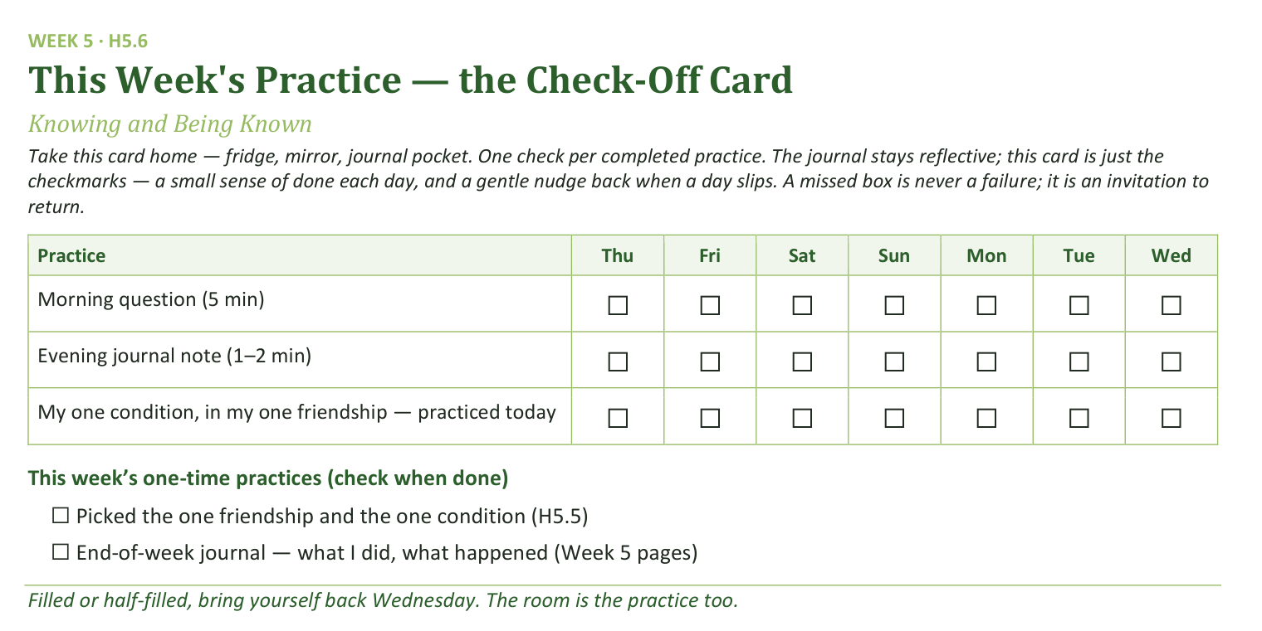
Your Take-Home Card — This Week’s Practice
Handed out now — fridge, mirror, journal pocket.
68
Notes:
S5 · 8:20–8:24 · LEAD: CONTENT PRESENTER
BEATS:
1. Check-off card (H5.6): daily morning question, evening note, and the one-condition practice; two one-time boxes.
2. A missed box is never a failure — it is an invitation to return.
CUES: Rides inside the practice block.

Slide 12
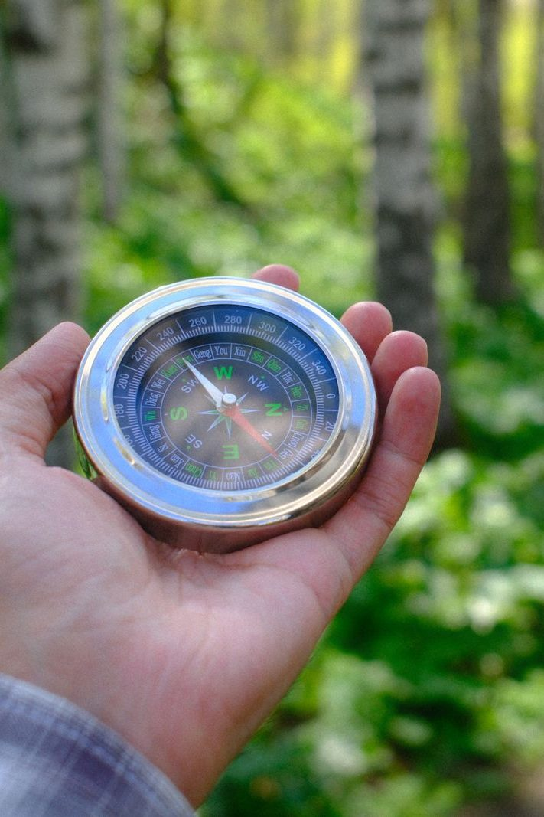
The Leader Feedback Round
• Two rounds, same as every session — the container holder first, then the content presenter: three things each
– “What I think went well tonight: ______”
– “What I’d do differently next time: ______”
– “If I were to teach tonight’s process to someone, I would tell them: ______”
• Then the room — the same two questions about tonight
• The leaders receive without defending — “thank you” is the whole response
69
Notes:
S5 · 8:24–8:28 · LEAD: BOTH LEADERS
BEATS:
1. Two rounds: the container holder first, then the content presenter. Three things each: went well; do differently; what I'd tell someone teaching today's process.
2. Then the room's two questions; two or three voices is plenty.
3. Receive without defending — 'thank you' is the whole response.
CUES: May be dropped if the room needs something else; twice running goes to the team debrief.

Slide 13
Closing the Container + Aaronic Blessing
• We close the way we opened — the container, six steps:
1 Stand again — same circle, same posture as the open
2 One-word landing — compare it to your opening word
3 The one thing you are taking from tonight
4 The one practice — committed aloud, or modified to one you will actually keep
5 Blessings — specific, witnessed, short
6 Closing prayer — and the Aaronic blessing, spoken over each other, face to face
THE AARONIC BLESSING — NUMBERS 6:24–26
“The Lord bless you and keep you;
the Lord make his face to shine upon you, and be gracious to you;
the Lord lift up his countenance upon you, and give you peace.”
70
Notes:
S5 · 8:28–8:30 · LEAD: CONTAINER HOLDER
BEATS:
1. 'What was named today is yours. The friendships you mapped are yours. Carry it gently.'
2. Name the open door: anyone who noticed they have no friendships with these conditions — reach out to the team; that is real, and not a problem to solve in five seconds.
3. Aaronic blessing. 'See you Wednesday.'

